Slide 1
Named Entity Disambiguation Boosted with Knowledge Graphs
Brian Lin
Shane Ong
Cory Williams Matteo Zhang

Slide 2
Motivation
There exists ~40 million Wikipedia articles!!!
Every day:
500 million tweets
450 million FB status updates
4.5 million blog posts
2 million news articles published

Slide 3
Motivation
There exists ~40 million Wikipedia articles!!!
Every day:
500 million tweets
450 million FB status updates
4.5 million blog posts
2 million news articles published

Slide 4
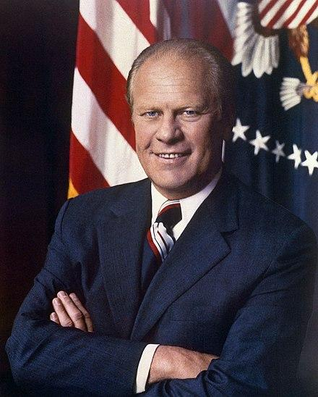
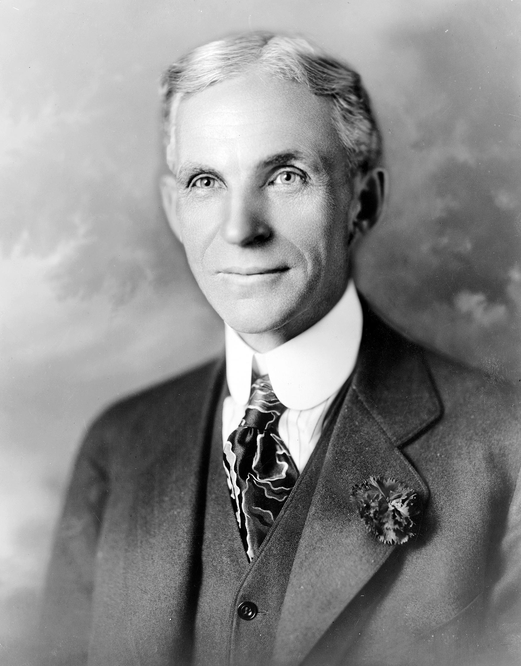
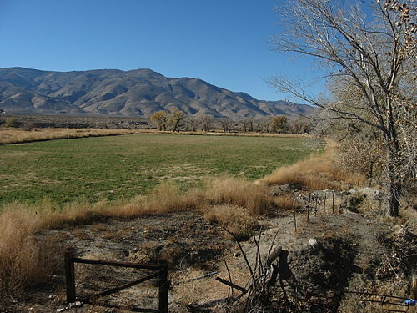
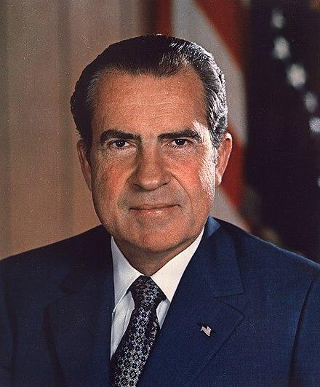
We tackle “Named Entity Disambiguation” within NLP
“President Ford granted a pardon to former President Nixon”

Slide 5
Literature Review
Candidate Entity Embeddings
Similarity Score
FFNN
LSTM
“President Ford granted a pardon to former President Nixon”

Slide 6
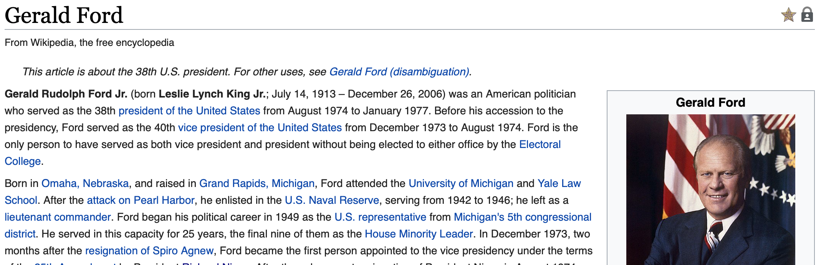
Description of Data - Wikipedia
Wikipedia data: text, link anchors, and redirects
5.9 million unique pages
135 million links to other Wikipedia pages
7.8 million unique anchor text and link pairs

Slide 7
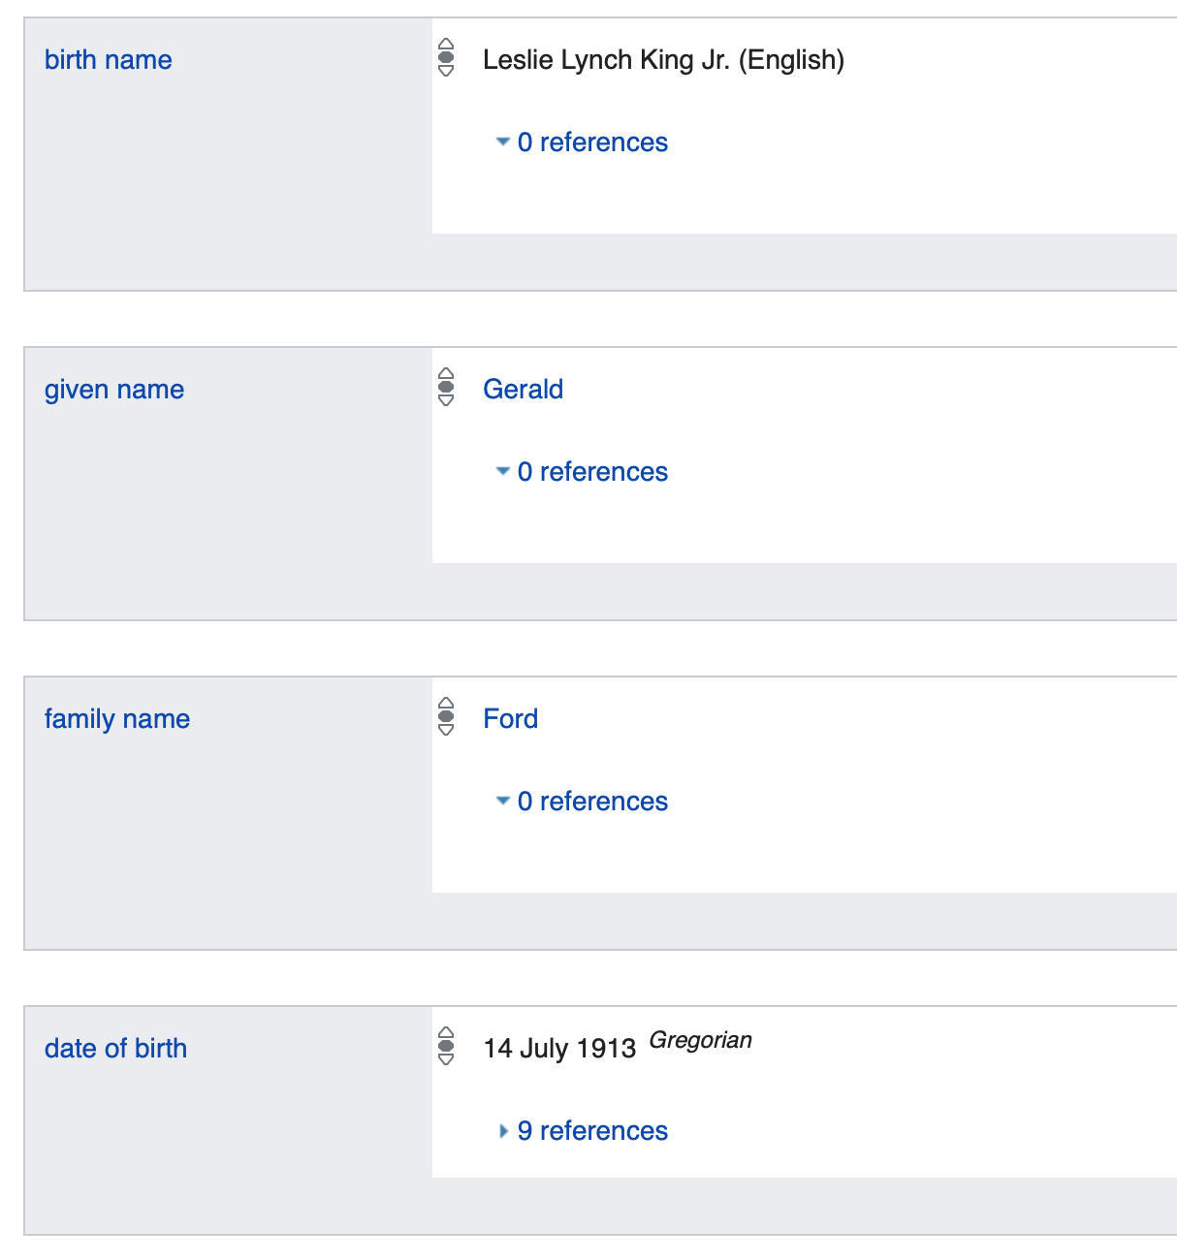
Description of Data - Wikidata
Wikidata data: triplets
383.2 million triplets
58.7 million entities
6490 types of relations
Ford
1913
Date of birth

Slide 8
We use knowledge graphs to “understand” text
1854
founded
Betty Bloom-er
Repub-lican Party
born
spouse
political party
Chica-go
Ford (presi-dent)
Yorba Linda
political party
born
born
1913
Nixon (presi-dent)

Slide 9
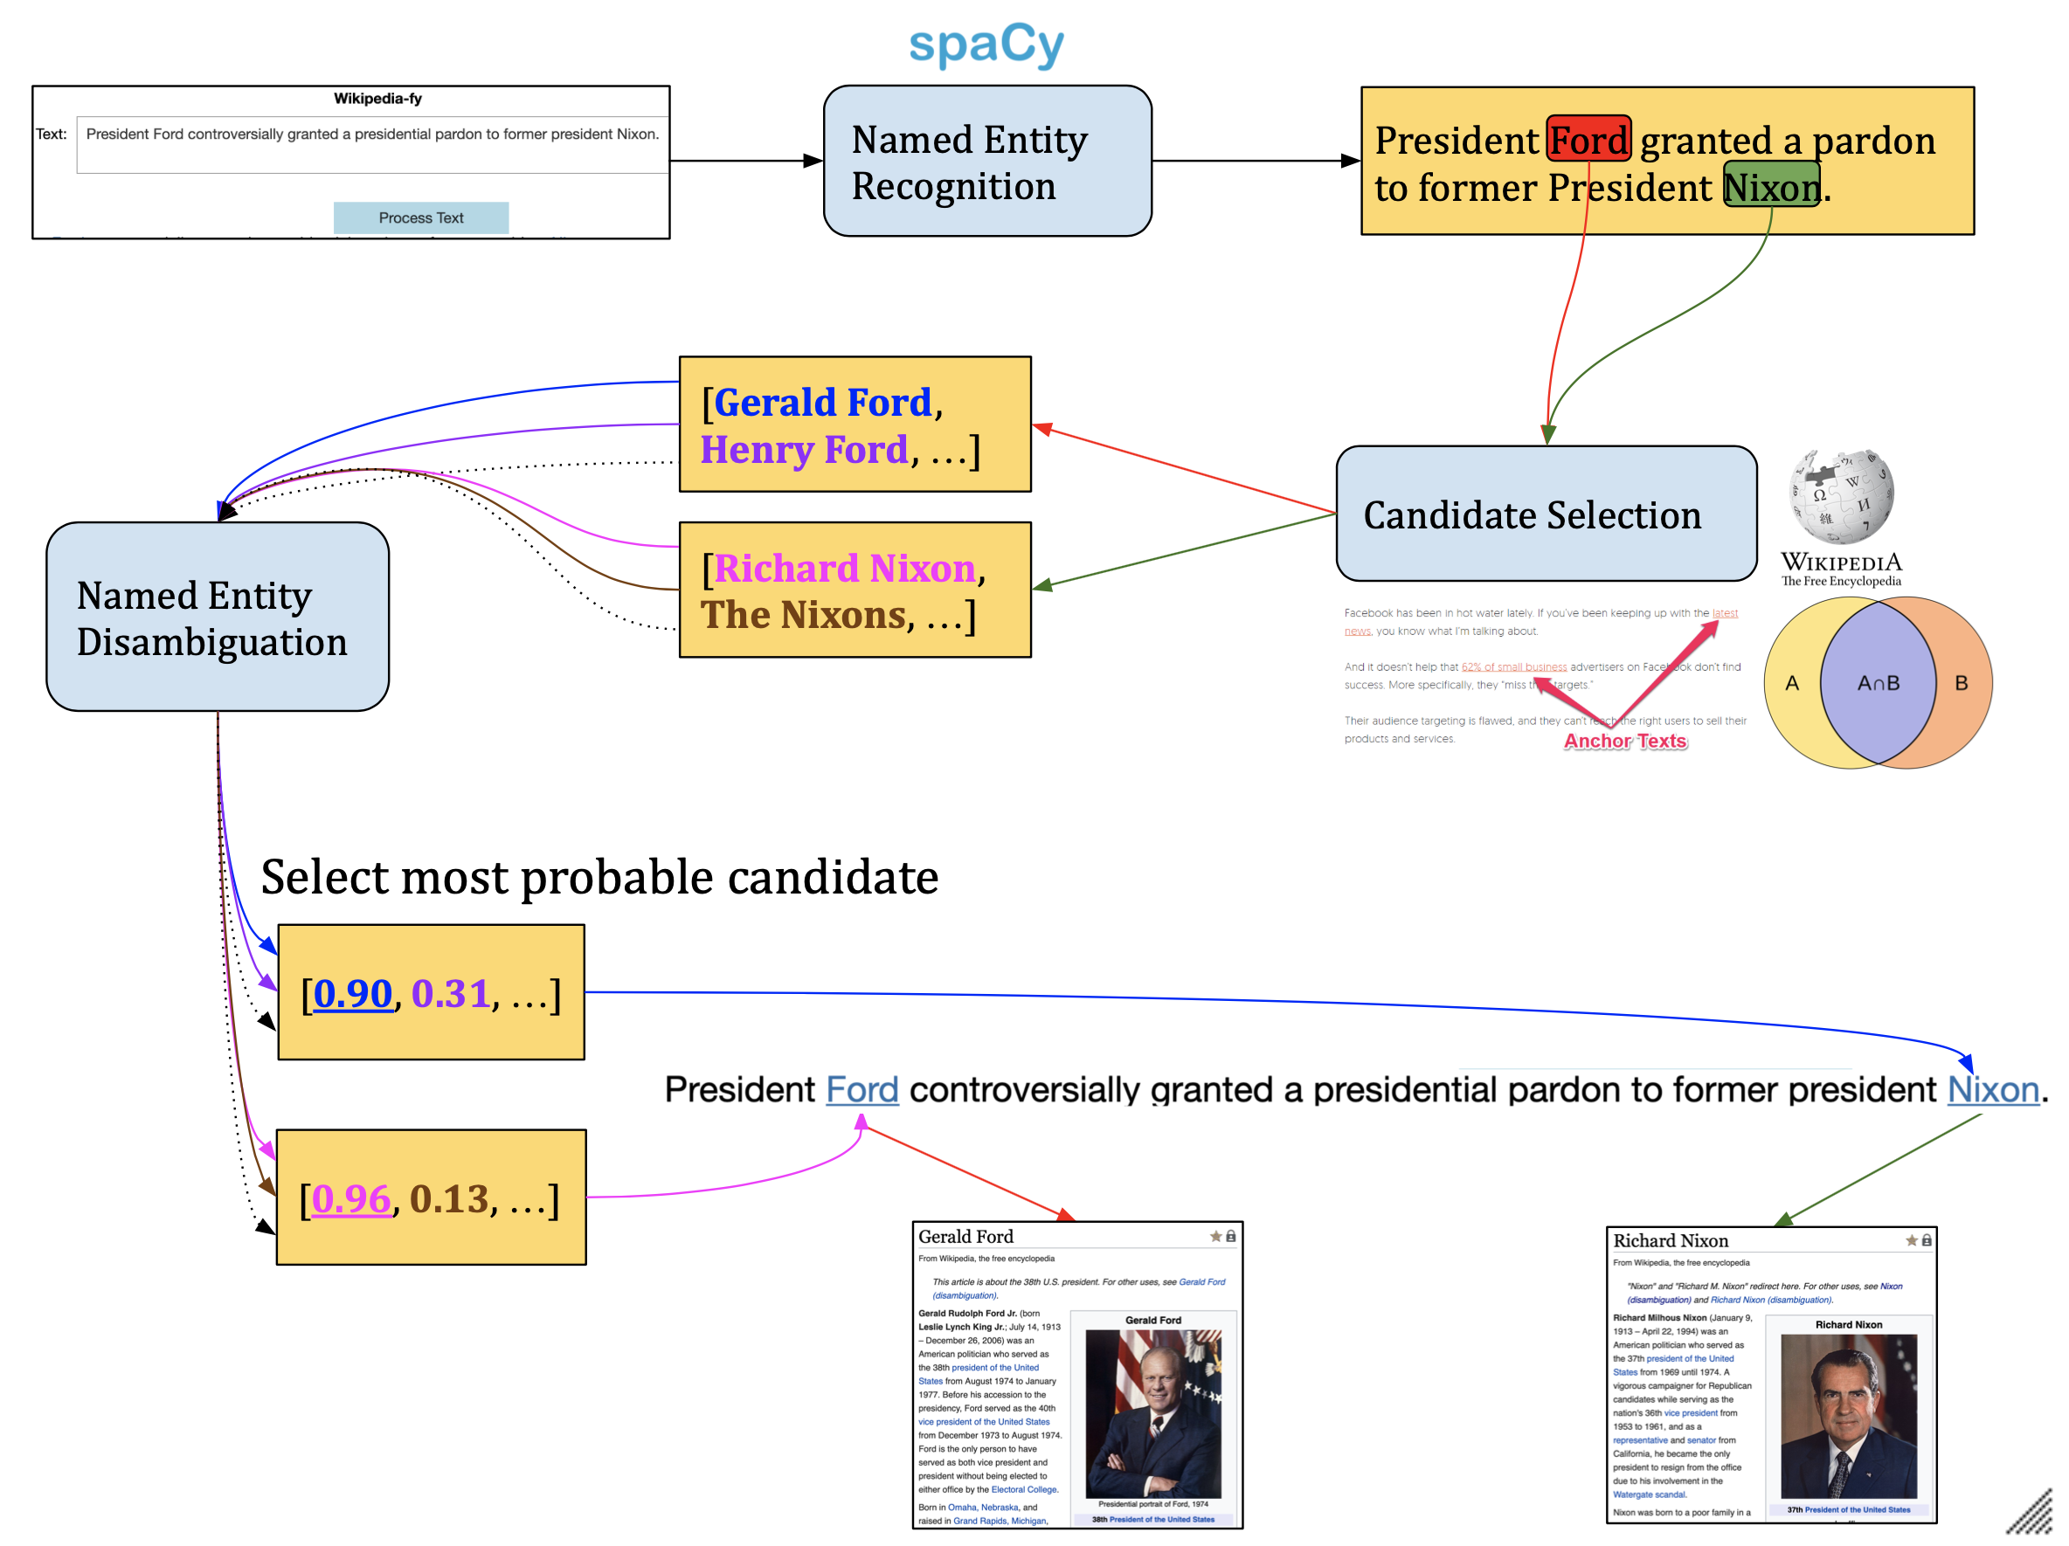
Overall Pipeline

Slide 10
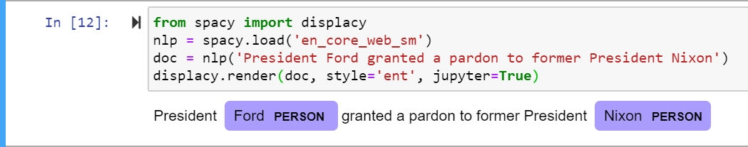
NER
Identify (and classify) named entity mentions with spaCy
spaCy NER uses a single layer NN with feature engineering

Slide 11
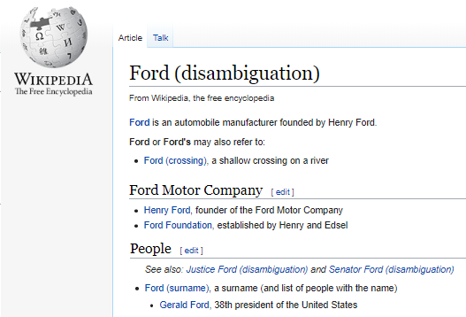
Candidate Selection
For each identified entity, select a candidate group of possible entities
Henry Ford
Ford Motor Company
Gerald Ford
“President Ford granted a pardon to former President Nixon”
Notes:
Brian

Slide 12
Candidate Selection
Anchor Text
Henry Ford
Ford Motor Company
Gerald Ford
“President Ford granted a pardon to former President Nixon”
Anchor Text
Anchor Text
Anchor Text
“Ford was one of the pioneers…”
“Ford served as the 40th ...”
“Ford was one of the first companies…”
Candidate List 1
Henry Ford, Ford Motor Company, Gerald Ford, ...

Slide 13
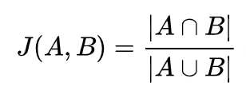
Candidate Selection
“President Ford granted a pardon to former President Nixon”
Jaccard Similarity
Estimated efficiently by locality-sensitive hashing
J(“Ford”, “Fjord”) = 5/6
Jaccard Similarity with Ford
Fjord
Henry Ford
Fordson
USS Ford
Candidate List 2
Fjord, Henry Ford, Fordson, USS Ford, ...

Slide 14
Base Model
Find all triplets that involve candidate Wikidata items
Use degree centrality to determine best candidate for each entity
Founder of
Henry Ford
Ford Motor Company
Gerald Ford
Political party
Republican
Succeeded by
“President Ford granted a pardon to former President Nixon”
Political party
Richard
Nixon
Notes:
Brian

Slide 15
Base Model Analysis: Recall 48%
Only look at direct relations between candidate Wikidata items
Does not use contextual information (i.e. President)
Founder of
Henry Ford
Ford Motor Company
Gerald Ford
Political party
Republican
Succeeded by
“President Ford granted a pardon to former President Nixon”
Political party
Richard
Nixon
Notes:
Brian

Slide 16
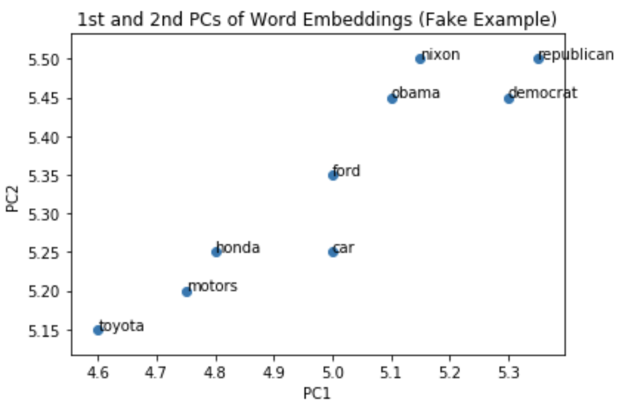
Word Embeddings
Goal
v₁
v₂
…
v₁₀₀
Word

Slide 17
Word Embeddings
Word2Vec
Efficient Estimation of Word Representations in Vector Space
Mikolov et al. (ICLR 2013)
GloVe
GloVe: Global Vectors for Word Representation
Pennington et al. (EMNLP 2014)
BERT
BERT: Pre-training of Deep Bidirectional Transformers for Language Understanding
Devlin et al. (NAACL 2019)

Slide 18
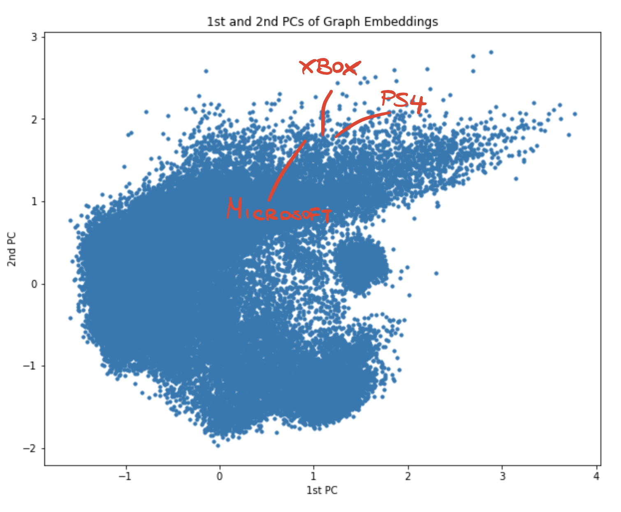
Knowledge Graph Embeddings
Goal
v₁
v₂
…
v₂₅₀
Node

Slide 19
Knowledge Graph Embeddings
RESCAL
RESCAL: A Three-Way Model for Collective Learning on Multi-Relational Data
Nickel et al. (ICML 2011)
DistMult
Embedding Entities and Relations for Learning and Inference in Knowledge Bases
Yang et al. (ICLR 2015)
RotatE
RotatE: Knowledge Graph Embedding by Relational Rotation in Complex Space
Sun et al. (ICLR 2019)

Slide 20

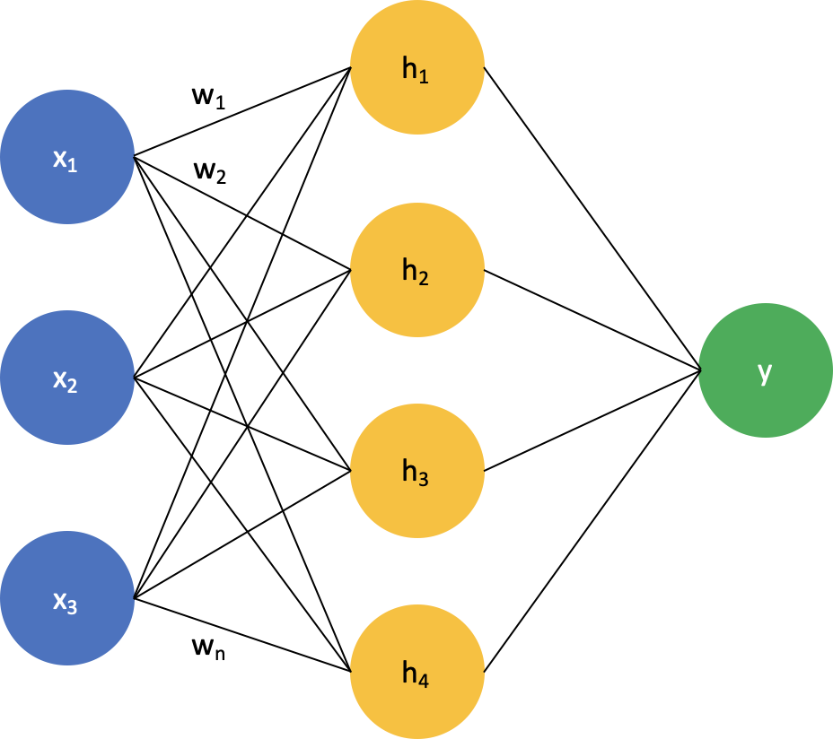
Final Model
TEXT
CANDIDATE LIST
President Ford granted a pardon to former President Nixon.
[Gerald Ford, Henry Ford, …]
Word Embedding Layer
Context window size k
Pretrained
Knowledge Graph Embeddings
[w₁, w₂, …, w_{k}]
Word Embeddings
[e₁, e₂, …]
Knowledge Graph Embeddings
Bidirectional LSTM
One embedding
at a time
o
[o, e_{i}]
[0.90, 0.31, …]
Select most probable candidate
Gerald Ford

Slide 21
Final Model
TEXT
CANDIDATE LIST
President Ford granted a pardon to former President Nixon.
[Gerald Ford, Henry Ford, …]
Word Embedding Layer
Context window size k
Pretrained
Knowledge Graph Embeddings
[w₁, w₂, …, w_{k}]
Word Embeddings
[e₁, e₂, …]
Knowledge Graph Embeddings
Bidirectional LSTM
One embedding
at a time
o
[o, e_{i}]
[0.90, 0.31, …]
Select most probable candidate
Gerald Ford

Slide 22
Final Model
TEXT
CANDIDATE LIST
President Ford granted a pardon to former President Nixon.
[Gerald Ford, Henry Ford, …]
Word Embedding Layer
Context window size k
Pretrained
Knowledge Graph Embeddings
[w₁, w₂, …, w_{k}]
Word Embeddings
[e₁, e₂, …]
Knowledge Graph Embeddings
Bidirectional LSTM
One embedding
at a time
o
[o, e_{i}]
[0.90, 0.31, …]
Select most probable candidate
Gerald Ford

Slide 23
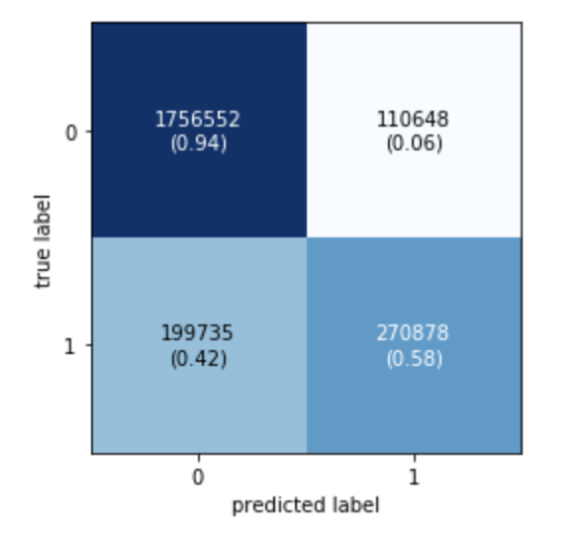
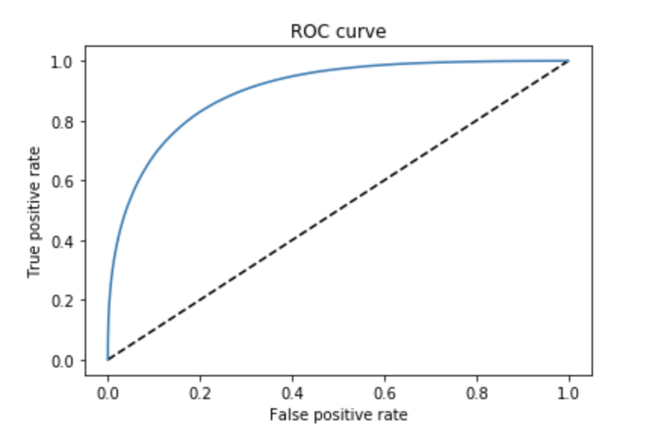
Final Model Results
Training Set: 9.3 million rows, Test Set: 2.3 million rows
20.11% positive, 79.89% negative labels
Window size: 20
Test Accuracy: 0.8676
AUC = 0.9014

Slide 24
Final Model Candidate List Results
“President Ford granted a pardon to former President Nixon”
From candidate selection:
Candidate List = [Gerald Ford, Henry Ford, Ford Motor Company]
NED: Select the the highest predicted probability:
Gerald Ford : 0.8
Henry Ford: 0.4
Ford Motor Company: 0.2
Test set recall: 0.758

Slide 25
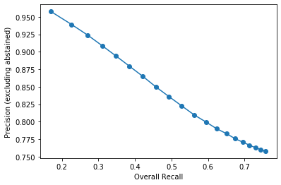
Abstaining Prediction
Candidate list with missing candidates
Option of abstaining when max probability below threshold
Without abstaining:
Test precision: 0.758
Test recall: 0.758
Abstaining at threshold = 0.2:
Test precision: 0.771
Test recall: 0.695

Slide 26
Demo
Jupyter Notebook Interface to Wikipedify a sentence

Slide 27
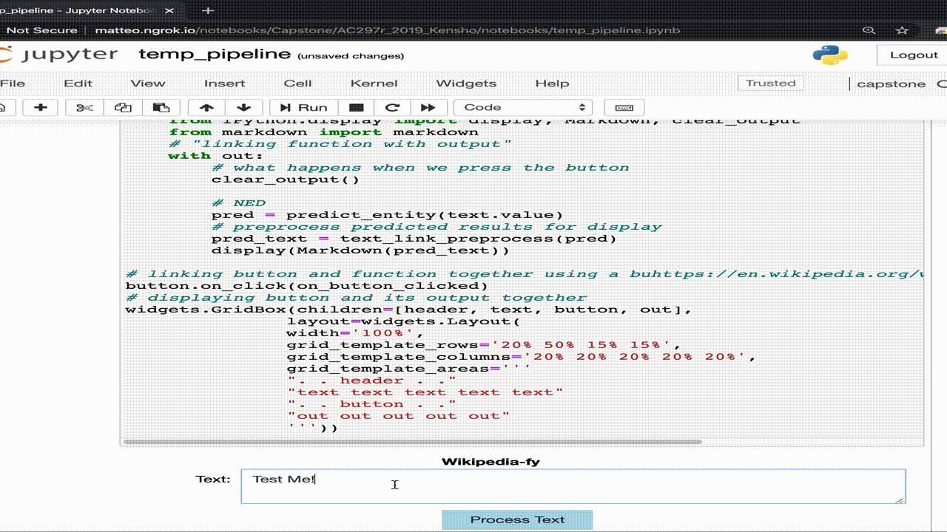
Demo - What worked

Slide 28
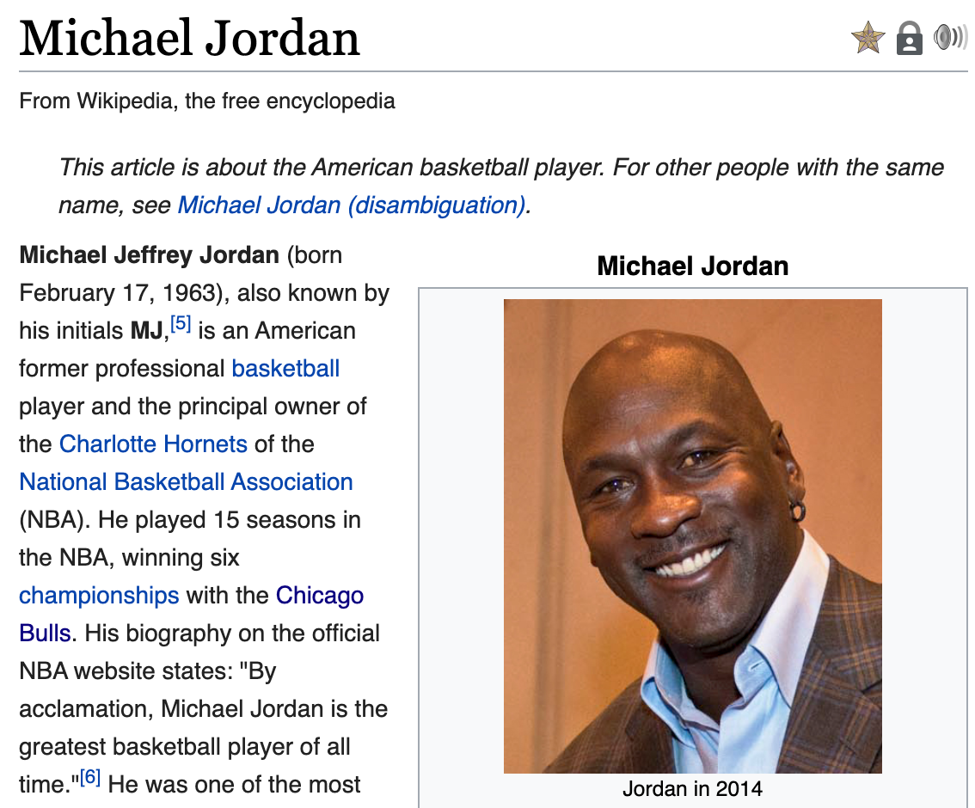
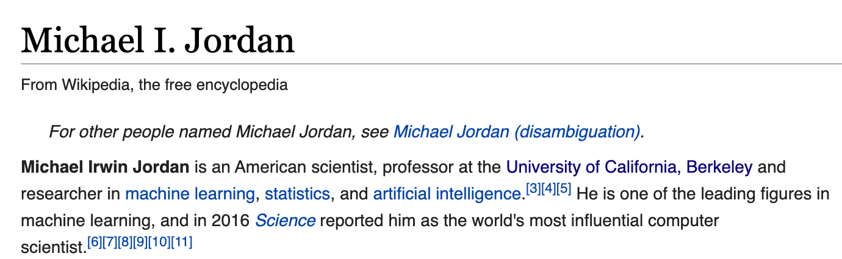
Demo - What worked
“Michael Jordan was a basketball player on the Chicago Bulls.”
“Professor Michael Jordan is a statistician. He’s at Berkeley.”
Model making sensible choices
Able to differentiate between the basketball player and the ML researcher!

Slide 29
Demo - What did not work
“Apple was the brain-child of Steve. It has produced numerous innovations such as Iphone”

Slide 30
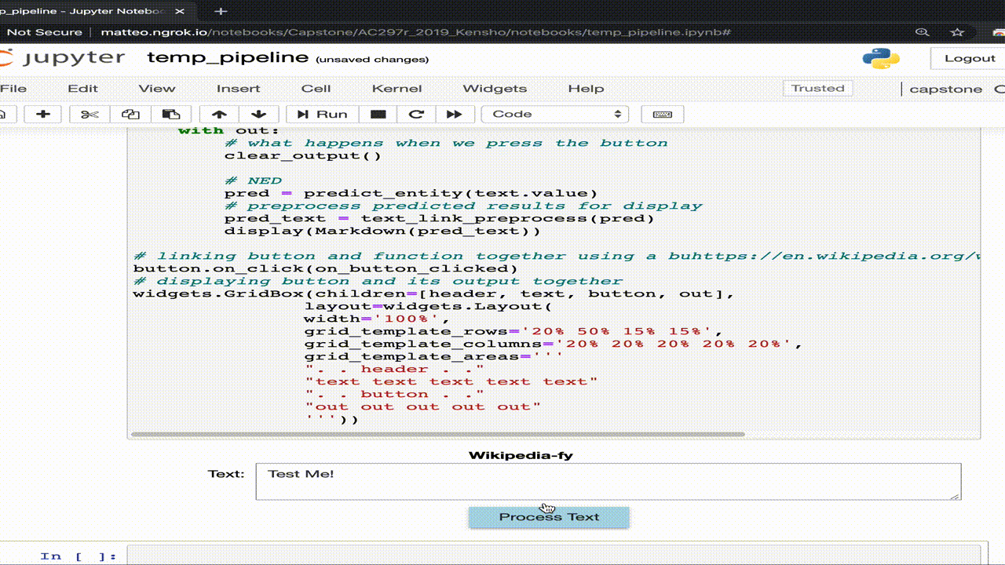
Demo - What did not work

Slide 31
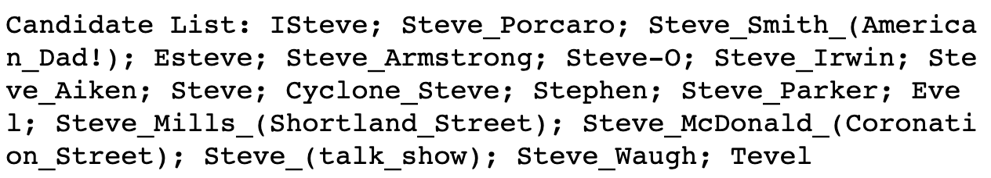
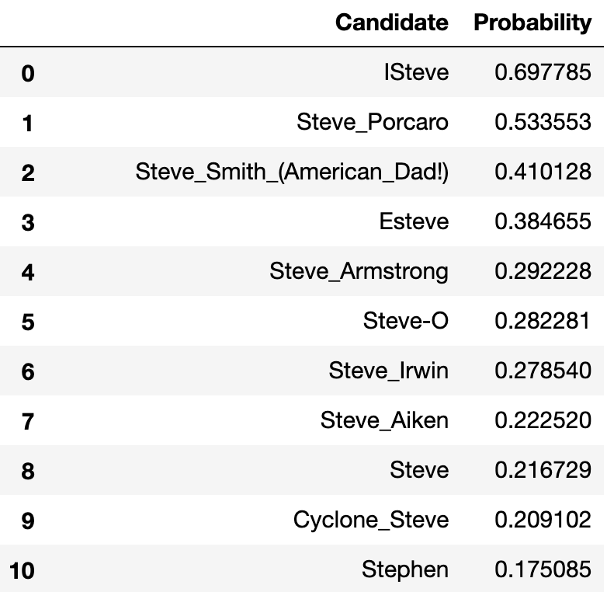
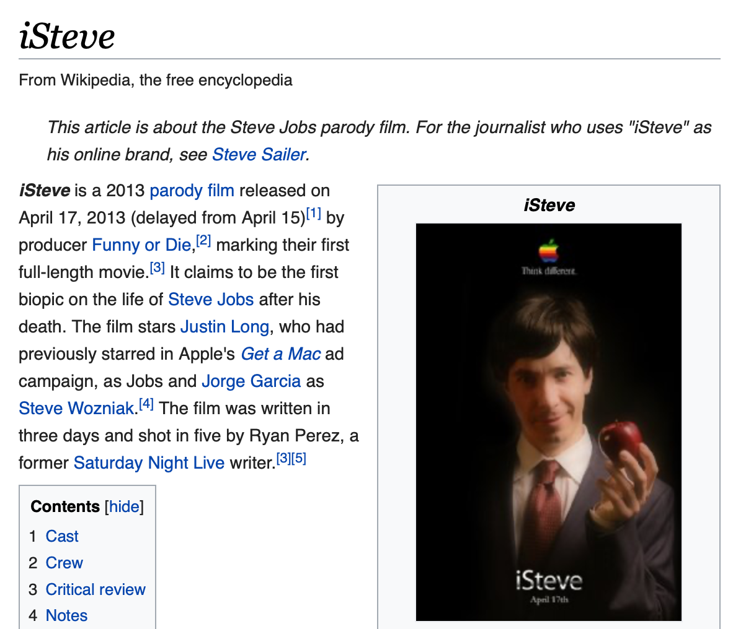
What went wrong
Steve
Steve Jobs not on the candidate list:
Notes:
18 candidates

Slide 32
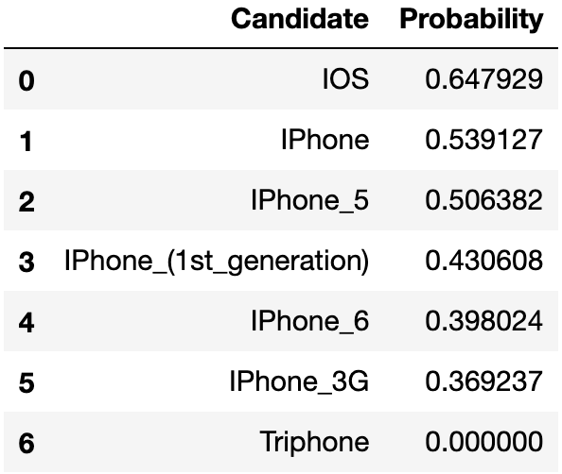
What went wrong
iPhone
iOS (iPhone OS) ranked higher than iPhone

Slide 33
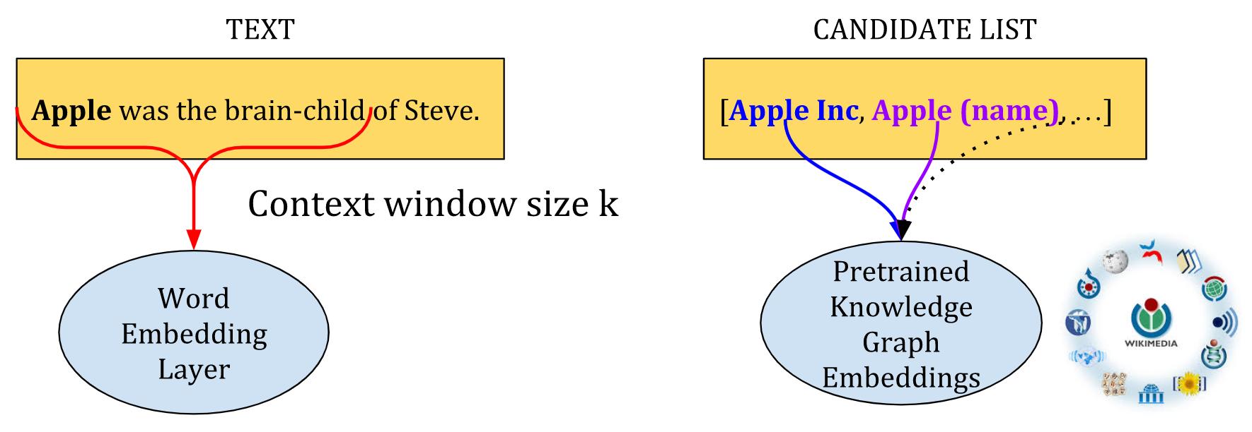
What went wrong
iPhone
Model:
only based on context + graph connections
does not penalize candidate text dissimilarity
“Apple was the brain-child of Steve. It has produced numerous innovations such as iOS”

Slide 34
Future Work
Improve the bottleneck: candidate list
Heavy feature engineering
Model:
Loss function to penalize candidate text dissimilarity: distance on word embedding space
Fine Tuning BERT
Jointly train all 3 stages together as one model
NER:
Other Kensho group
Notes:
Issues related to candidate list:
Abstaining to avoid high inaccuracy
Cascading error when not present
And too …
Loss function using word embeddings

